Slide 1
SDSC 2005 - Introduction to Computational Social Science
(Lecture 2)
Hao PENG
(haopeng@cityu.edu.hk)
Department of Data Science
City University of Hong Kong
https://haoopeng.github.io/

Slide 2
Agenda for Week 2
Data collection, APIs
Requests, BS4, Json
Data preprocessing
Python tutorial
  Requests
  BeautifulSoup
  OpenAlex / Wikipedia API
Last minute to find a home group
  If not, you will get a random home after today
  Each group can have max. 6 students (class size: ~95)
  18 teams in total so that each group can have ~20 mins.

Slide 3
If you need python material
Check out Chuck Severence’s Python for Informatics:
https://do1.dr-chuck.net/py4inf/EN-us/book.pdf

Slide 4
Before we can analyze data or make fancy visualizations….
We need some data to analyze / visualize!
Get some data
Clean it up, transform it
Explore it,
analyze it, visualize it
Communicate something interesting
GET
MANIPULATE
LEARN
TELL
This lecture

Slide 5
What are Data?
For individuals (people, objects, etc.), measurements are taken for some variables, and the resulting measurement values are data.
Variable is a characteristic of an individual, and it has two types:
  categorical a.k.a qualitative (e.g., gender, personality type)
    A categorical variable is called ordinal if its categories can be ordered (e.g., letter grade, edu level)
  numerical a.k.a quantitative (e.g., height, weight, age)
Note: Only numerical variables allow arithmetic operations.
Categorical variables do not. Most of them have no ordering.
Notes:
Categorical: assign individuals to different catergory.
Quantitative: represent amounts

Slide 6
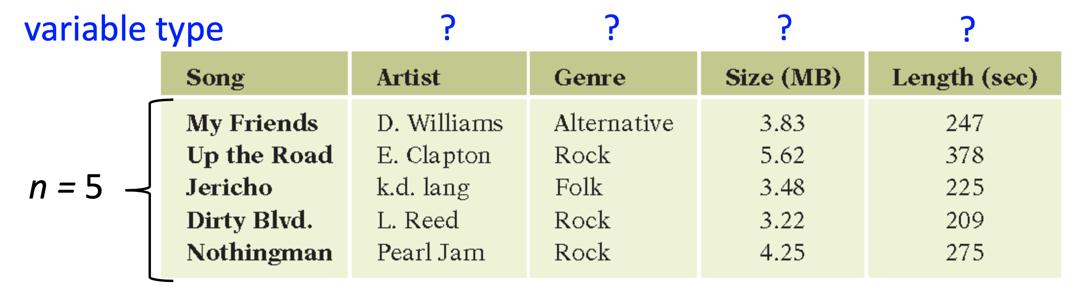
Data Tables
Columns correspond to variables.
Rows correspond to individuals, often called observations.
The number of rows is traditionally denoted as n.

Slide 7
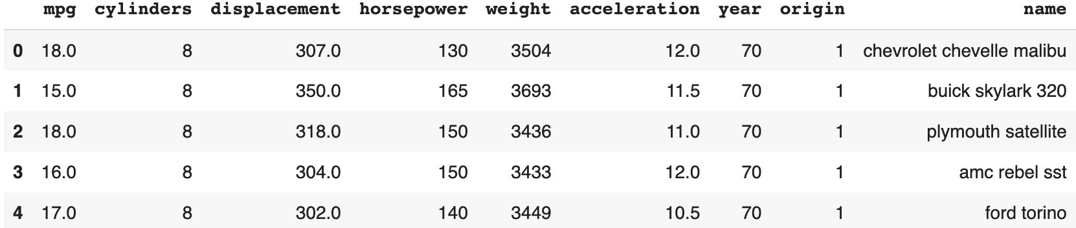
Example from Python
Auto.csv: information for cars
mpg: miles per gallon
cylinders: number of cylinders
displacement: engine displacement
horsepower: engine horsepower
weight: vehicle weight
acceleration: time to accelerate
year: model year
origin: origin of car
(1. American, 2. European, 3. Japanese)
name: vehicle name

Slide 8
Data collection methods
How many students with height 165-170cm in the class?
Observations
  Simply looking at students around you
Tests & Experiments
  Soft ruler
Surveys
  Questionnaire
    Interview
    Email
    Call
Databases (structured vs. unstructured)
  Check your medical record
  Use APIs to query data from data server
Notes:
Tax and providing support for college tuition fee

Slide 9
Example of survey design
For instance, there are two questions A and B.
  Will you support free college tuition?
  Will you support a tax increase to fund college?
Those who answered yes to A when the questions appear in the order (A,B) would try to be consistent and answer yes to B.
Due to cognitive bias, respondents to questionnaires generally try to be consistent in their responses to questions. Thus, the collected data may be biased.
Survey is tricky and complicated!

Slide 10
Modern social data is ubiquitous
Data is central to organizations and decision-makings.
There is a huge volume of data around us!
(http://www.internetlivestats.com/)
Thousands of APIs and web services
  Twitter, Instagram, Wikipedia, LLMs (GPT-4o), etc.
  OpenAlex, Microsoft Academic Graph, USPTO, etc.
  > 16,000 APIs (programmableweb.com)

Slide 11
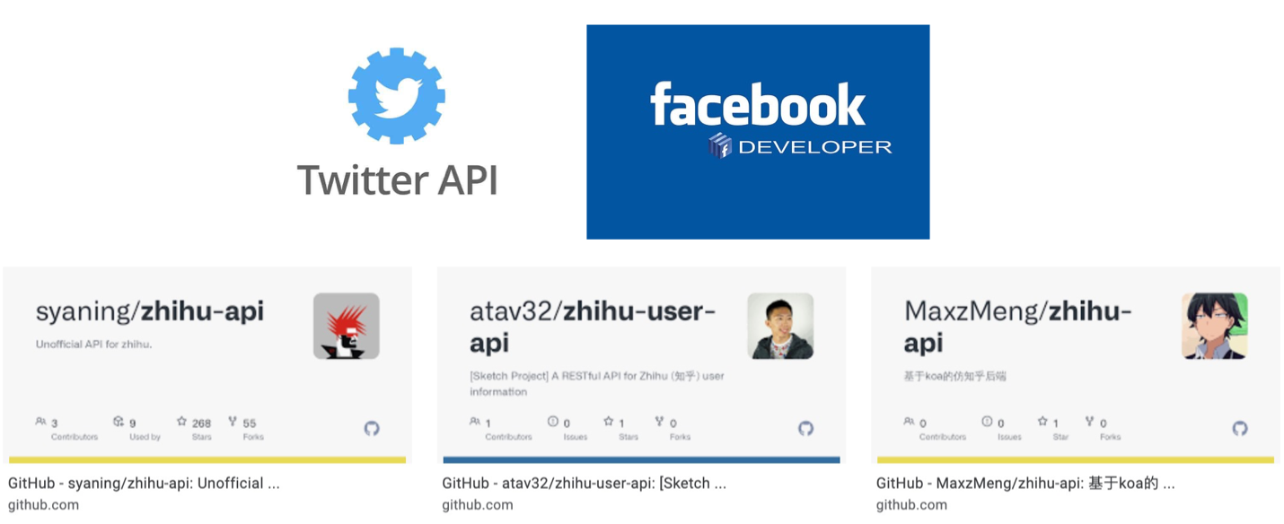
How to collect big social data?
API is the easiest (first and third-party APIs)
Build customized web crawler (parse data in html)
Browser-like crawler (e.g., Selenium, LLM agent)

Slide 12
What’s an API
An Application Programming Interface (API) is a set of rules and protocols that allows different software applications to communicate with each other. APIs define the methods & data formats that applications can use to request & exchange information.

Slide 13
Two basic things that APIs do
Retrieve data according to some query (like how you would get data from a database via SQL query)
Perform some sophisticated computation on data that you send to the API

Slide 14
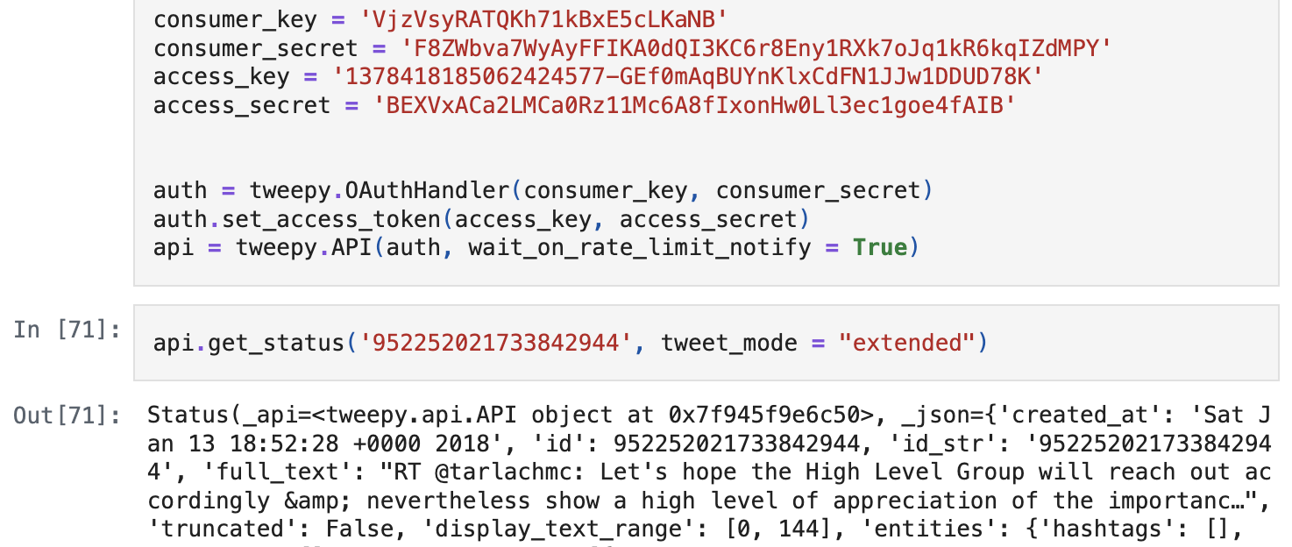
Tweets via 3rd party API wrapper
Complex Twitter API: https://github.com/xdevplatform/Twitter-API-v2-sample-code
Tweepy: Python library for easy interaction with the Twitter API: https://github.com/tweepy/tweepy/

Slide 15
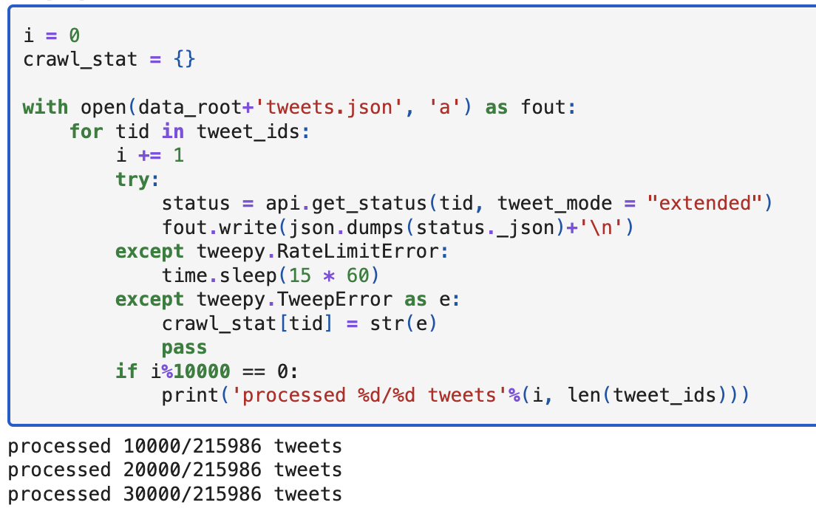
Collecting Tweets using Tweepy
Print out progress (when collecting large datasets)
Sleep for a while to avoid hitting rate limits

Slide 16
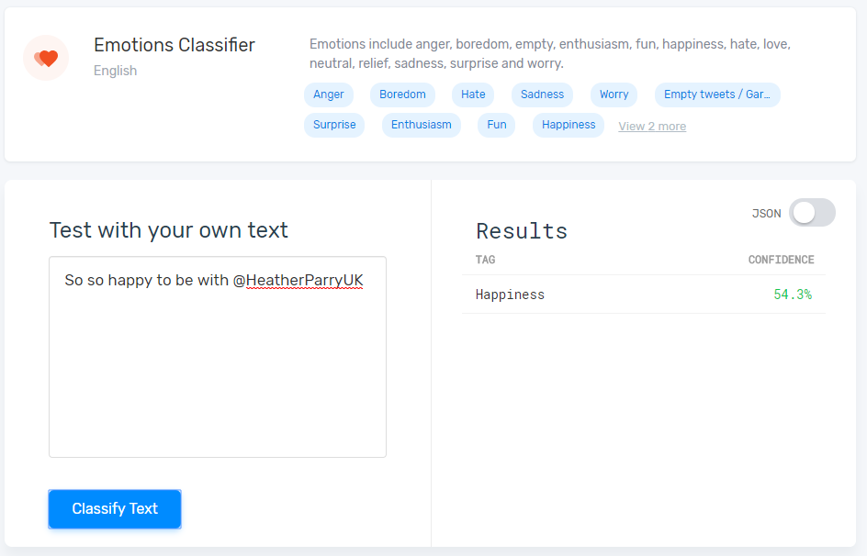
Computationally-oriented APIs
E.g., MonkeyLearn API:
https://github.com/monkeylearn/monkeylearn-python

Slide 17
Computationally-oriented APIs
from monkeylearn import MonkeyLearn
ml = MonkeyLearn('bd321e7772444c114885de7ad3371b69ac6286f8')
module_id = 'cl_mEcCuEcG’
text_list = ["So so happy to be with @HeatherParryUK"]
res = ml.classifiers.classify(module_id, text_list)

Slide 18
Computationally-oriented APIs
res.body
[{'text': 'So so happy to be with @HeatherParryUK',
'external_id': None,
'error': False,
'classifications': [{'tag_name': 'Happiness',
'tag_id': 55168807,
'confidence': 0.543,
'parents': [{'tag_name': 'Positive’,
'tag_id': 55168804,
'confidence': 0.692}]}]}]

Slide 19
What if there is no API wrapper?
Work with APIs using the requests library
Most APIs utilize the URL technology
  URLs (Uniform Resource Locators) serve as the core mechanism for identifying and locating resources on the internet. This approach leverages the existing infrastructure and principles of the WWW.
  Unique identifier for each web resource
  Structured format (e.g., http://, https://)
  Standard protocol for communication and exchange information between the client and the server

Slide 20
Interacting with APIs in Python
In the old days: sockets, HTTPClient, urllib2
Now: requests
Note: It can be used to access any webpage with a URL
  API-based URLs
    e.g., your Instagram/X/LinkedIn webpage (vs. apps)
    https://x.com/haoopeng
  URLs for static pages (e.g., https://haoopeng.github.io/)
  URLs for dynamic/complex websites (not our focus!)
    e.g., A NYT article with comments updated in real time.
Notes:
I don’t have full control of data shown in my twitter page (e.g., a random people can retweet my posts the next day), but I can fully control my github page.
Dynamic sites: shopping platforms / Taobao / HK TV mall

Slide 21
Web-based API Basics
Input: URL with params: http://something/foo/bar?x=y...
HTTP GET (or POST) the URL
Output: JSON or HTML result
Note again: Not all URLs are for APIs:
URLs for plain websites: designed for humans to access web pages. They are used for content display in a web browser.
URLs for APIs: designed for access by software applications. They serve as endpoints for apps. to request & exchange data.
Notes:
e.g., your profile page on LinkedIn

Slide 22
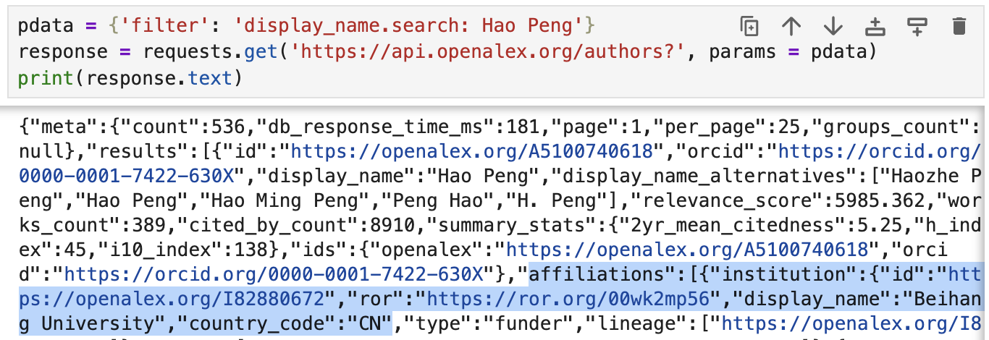
Accessing APIs with requests
Search for authors by name in OpenAlex database:
Check out results in your web browser:
https://api.openalex.org/authors?filter=display_name.search%3AHao+Peng

Slide 23
What if there is no API at all?
Work with html directly using the requests library
import requests
response = requests.get('http://data.pr4e.org/romeo.txt')
print(response.text)
But soft what light through yonder window breaks
It is the east and Juliet is the sun
Arise fair sun and kill the envious moon
Who is already sick and pale with grief
What about more complicated websites?
Nested websites / urls
Target content buried in html/css markup language

Slide 24
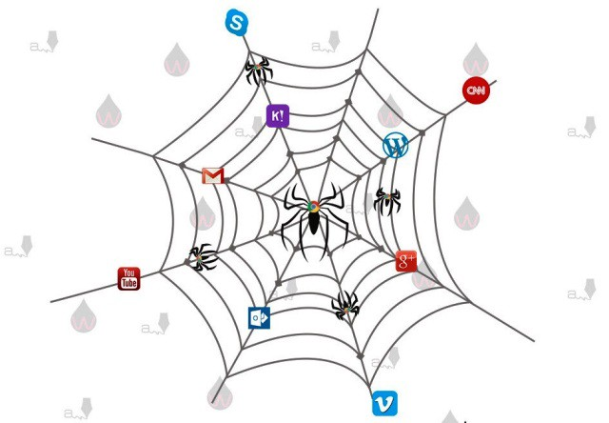
Welcome to Web Crawling
A script to collect your target information from the Internet – a spider on the web:
Automatic (machine strength)
Save you time
The spider would follow all your commands and would not make any mistakes (hopefully).
https://medium.com/@csgsajeewa/sample-web-crawler-using-crawler4j-8033bfcd8e60

Slide 25
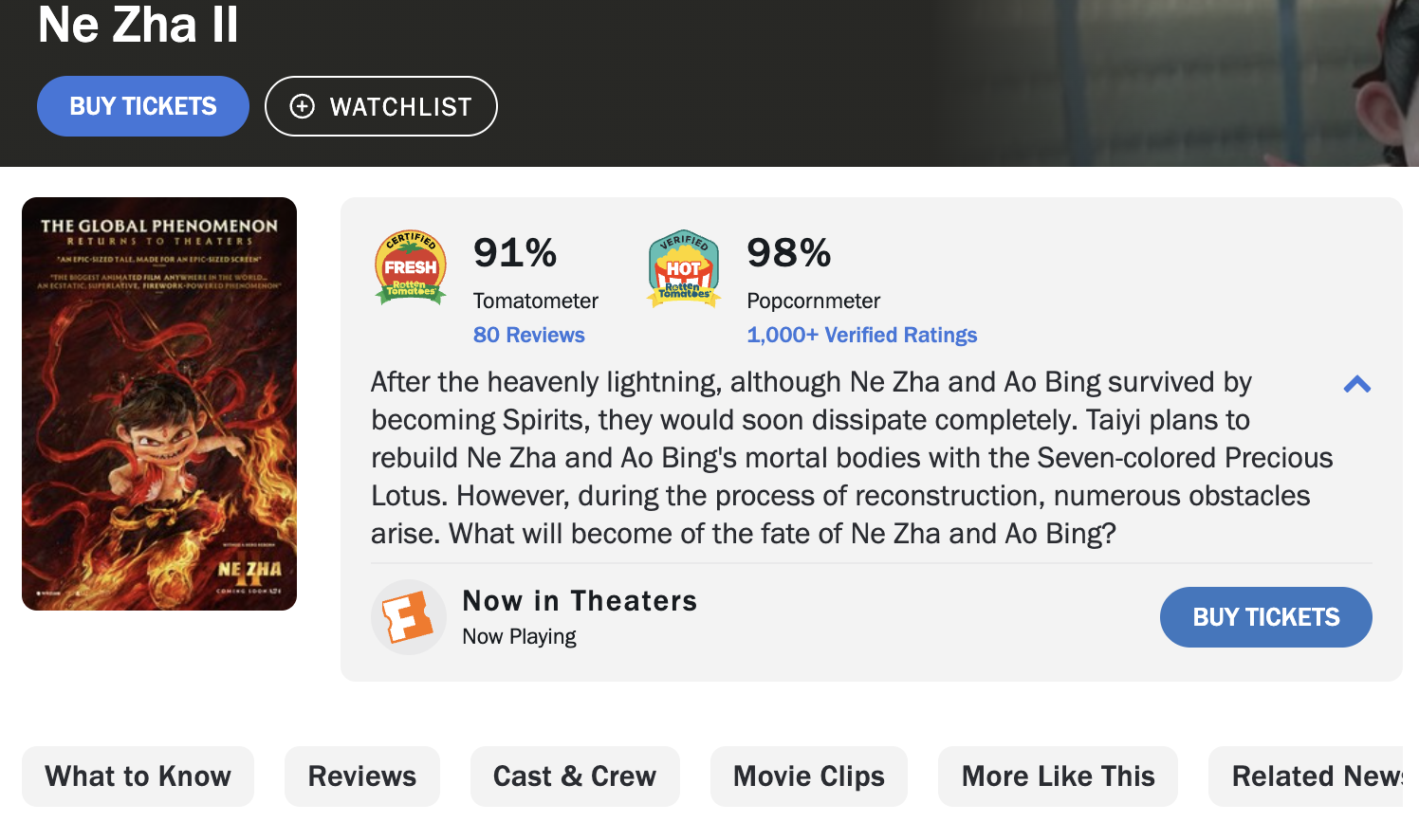
Case study: RottenTomatoes
Collect the titles, ratings, No. of reviews, and detailed comments of Top 100 movies of the 21st Century
  https://editorial.rottentomatoes.com/guide/best-movies-21st-century/

Slide 26
Step 1: Inspect your data source
Decipher URLs for the content you want
  The base URL:
  https://editorial.rottentomatoes.com/guide/best-movies-21st-century/
  The specific site location for each movie:
    https://www.rottentomatoes.com/m/ parasite_2019
    https://www.rottentomatoes.com/m/modern_times
    https://www.rottentomatoes.com/m/avengers_endgame
  More specific site location for reviews:
  https://www.rottentomatoes.com/m/avengers_endgame/reviews https://www.rottentomatoes.com/m/avengers_endgame/reviews?type=top_critics https://www.rottentomatoes.com/m/avengers_endgame/reviews?type=user
The URLs are more like tree structure
  Clicked on the website and see how the URL changes.

Slide 27

Step 1: Inspect your data source
Browser’s developer tools.
Right-click on the page and select the “Inspect” option.
Example structure of the website source code (HTML).
Right-click the target element on the page and select “Inspect” to identify their location in the source code.
tag
properties
properties
text
end of tag

Slide 28
Step 2: Divide your tasks
Get the description link of each movie from: https://editorial.rottentomatoes.com/guide/best-movies-21st-century/
Collect title, ratings, reviews from each movie’s URL. E.g. https://www.rottentomatoes.com/m/parasite_2019
Collect detailed review comments from: E.g. https://www.rottentomatoes.com/m/parasite_2019/reviews

Slide 29
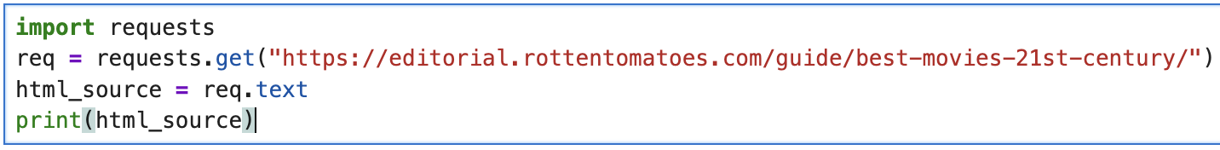
Step 3: Get the html content
Use requests to get the source html of each webpage.
  Retrieve HTML content (including CSS) from the server
  requests can only retrieve full content of static sites!
Static websites (we will focus on this type)
  The data fetched by requests contain all the information as shown on the browser, including your target data.
Dynamic websites (not covered in this course)
  Not all information can be fetched by requests.
  Data shown in browser can be stored in a database on server.
  Need to use browser-like crawler (e.g., Selenium).

Slide 30
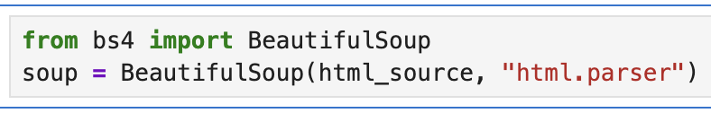
Step 4: Process HTML source code
Can build your own regular expression to match the data you want (time consuming but more powerful)
Beautiful Soup (available as a Python package)
  https://www.crummy.com/software/BeautifulSoup/
  Interact with HTML similarly to how you would interact with a webpage using the developer tool.
Just create a BS object with the whole html string
  Can use different parsers depending on type of source data
  https://www.crummy.com/software/BeautifulSoup/bs4/doc/#differences-between-parsers

Slide 31
Step 4: Process HTML source code
Find elements via the BS object
  Use the tag and attribute to find elements you want.
  find(tag, attrs, recursive, text, **kwargs)
    https://beautiful-soup-4.readthedocs.io/en/latest/#find
    just find one matched result (the first one)
    tag: the tag where your data is contained
    attrs: more precise finding with additional attributes filters
  find_all(tag, attrs, recursive, text, limit, **kwargs)
    https://beautiful-soup-4.readthedocs.io/en/latest/#find-all
    return a list containing all the matched results
    limit: the number of results returned. Equals to find when limit=1

Slide 32
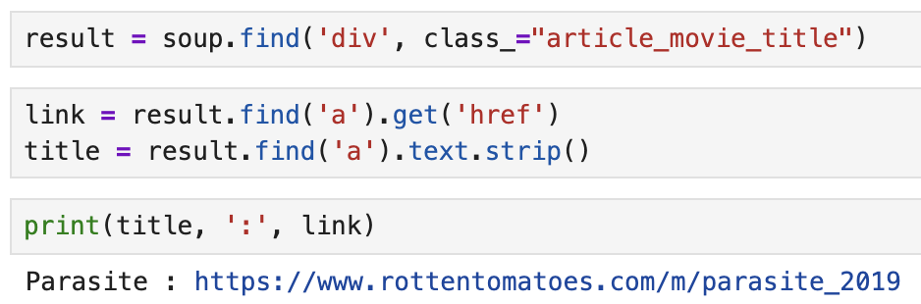
Step 4: Process HTML source code
Process matched elements:
  Find (nested) elements by tags and attributes
  Extract link from HTML element via [.get(‘href’)]
  Extract text from HTML element via [.text]
  Iterate through all movie URLs and collect reviews for each movie in a similar way using Python requests + BS4.
Notes:
Find rating: result.find('span', class_="tMeterScore").text

Slide 33
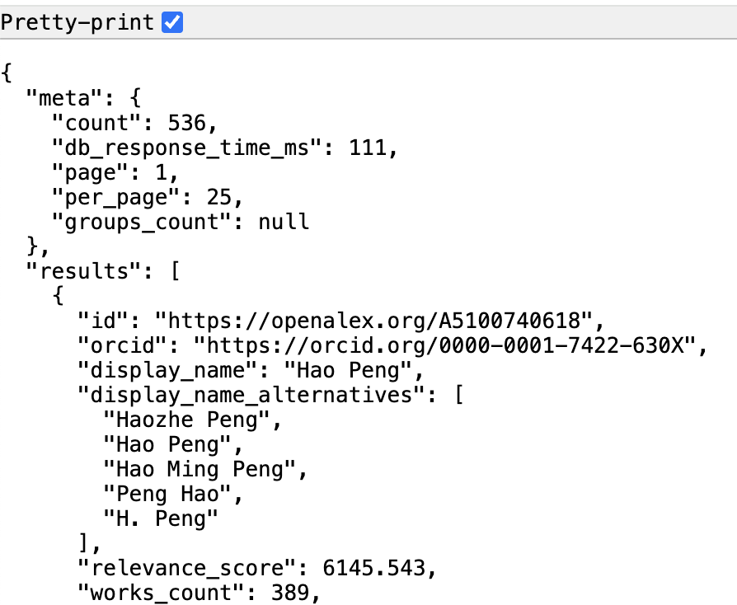
Why do most APIs return JSON?
Search authors in OpenAlex:
https://api.openalex.org/authors?filter=display_name.search%3AHao+Peng

Slide 34
JSON: JavaScript Object Notation
  {"employees": [
  { "firstName": "John", "lastName": "Doe" },
  { "firstName": "Anna", "lastName": "Smith" },
  { "firstName": "Peter", "lastName": "Jones" }
  ]
  }
JSON syntax is a subset of JavaScript
Two basic structures:
  Curly braces hold objects (aka dictionaries)
  Square brackets hold arrays (aka lists)
Filename extension ".json"
MIME type (e.g. HTTP header) application/json

Slide 35
Why do most APIs return JSON?
Application 1
Data store
(disk, database, etc)
Application 2
A
A
C
save
save
C
F
F
B
load
load
B
D
E
D
E
{'A': ['B', 'C'],
'B': ['C', 'D'],
'C': ['D'],
'D': ['C'],
'E': ['F'],
'F': ['C']}
(Instagram profile page displayed in your browser)
(Instagram profile page displayed in your IOS app)

Slide 36
Why JSON? Persistence
Common format, works in many languages
Simple, fast to parse
Human-readable
(Learned some lessons from XML/CSV…)

Slide 37
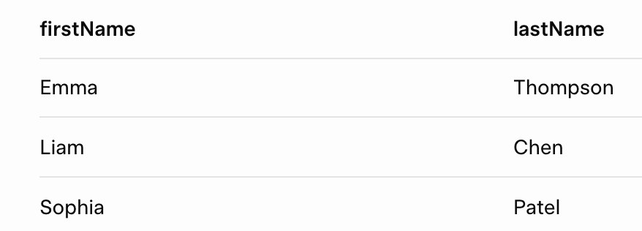
JSON vs CSV
Advantages
  Json is more expressive
  Supports more data types (str, num, bool, array, etc.)
  Json is more readable and standalone, especially for data with many variables
Weaknesses
  Json info. is redundant
  Json file size is larger
  CSV is shorter, simpler
  CSV is easier to edit
  CSV is faster to parse
JSON
{"employees": [
{ "firstName":"John" , "lastName":"Doe" },
{ "firstName":"Anna" , "lastName":"Smith" },
{ "firstName":"Peter" , "lastName":"Jones" }
]
}
CSV

Slide 38
JSON and Python
Default support:
import json
Decoding JSON strings into objects: loads = "load string"
json.loads(string) string -> Python object
Encoding Python objects into strings: dumps = "dump string"
json.dumps(object) Python object -> string
http://docs.python.org/3/library/json.html

Slide 39
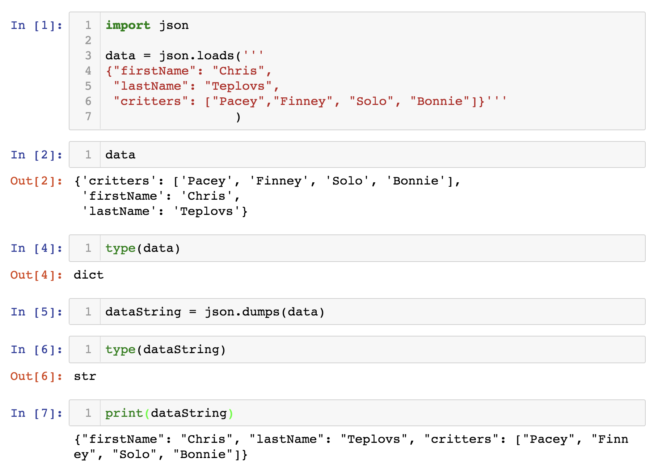
Decoding string to Json (loads)

Slide 40
Encoding Json to string (dumps)

Slide 41
Round-trips may not yield identical results
Encoding then decoding may not give exactly the same type
data = {'a': 'A', 'b': (2, 4)}
data_string = json.dumps(data)
data_string
# '{"a": "A", "b": [2, 4]}'

Slide 42
Round-trips may not yield identical results
Encoding then decoding may not give exactly the same type
data = {'a': 'A', 'b': (2, 4)}
data_string = json.dumps(data)
data_string
# '{"a": "A", "b": [2, 4]}'
decoded = json.loads(data_string)
decoded
# {'a': 'A', 'b': [2, 4]}
Python tuple becomes JSON array

Slide 43
Round-trips may not yield identical results
Encoding then decoding may not give exactly the same type
data = {'a': 'A', 'b': (2, 4)}
data_string = json.dumps(data)
data_string
# '{"a": "A", "b": [2, 4]}'
decoded = json.loads(data_string)
decoded
# {'a': 'A', 'b': [2, 4]}
Python tuple becomes JSON array
JSON array becomes Python list

Slide 44
Sorting keys in output
data = [{'a': 'A', 'b': (2, 4), 'c': 3.0}]
json.dumps(data)
# '[{"a": "A", "c": 3.0, "b": [2, 4]}]' # random key order
json.dumps(data, sort_keys=True)
# '[{"a": "A", "b": [2, 4], "c": 3.0}]' # sorted key order

Slide 45
Indentation in output:
data = [{'a': 'A', 'b': (2, 4), 'c': 3.0}]
print(json.dumps(data, sort_keys=True, indent=2))
[
  {
  "a": "A",
  "b": [
  2,
  4
  ],
  "c": 3.0
  }
  ]

Slide 46
Data preprocessing pipelines
Why preprocess the data?
How to clean the data?
Data transformation
Data reduction
Data discretization

Slide 47
Why
Data in the real world is dirty
  incomplete: lacking attribute values, lacking certain attributes of interest, or containing only aggregate data;
    Very often you don’t know why certain values are missing.
  noisy: containing errors or outliers
  inconsistent: discrepancies in codes or names
No quality data, no quality results!
  Quality decisions must be based on quality data
  Data warehouse needs consistent integration of quality data – this is often the most difficult part!

Slide 48
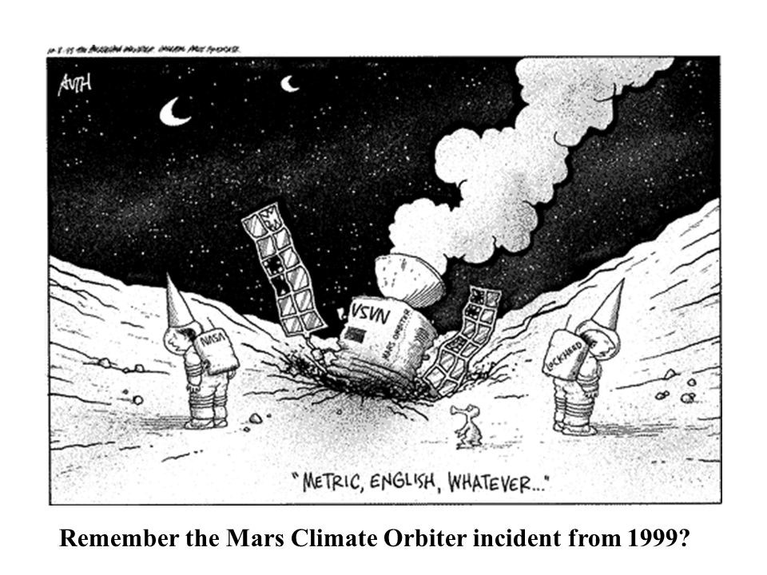
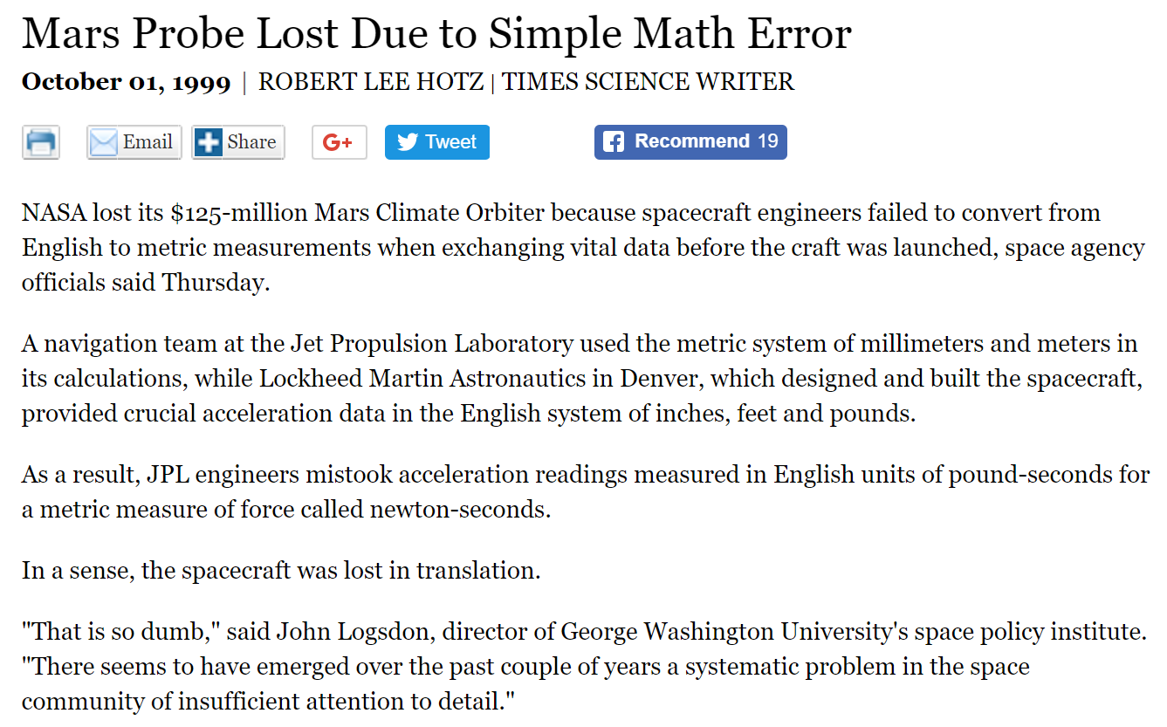
Inconsistency can be disastrous

Slide 49
Data processing is crucial step
Roughly 50-80% of initial work of a data science project involves data processing:
  accessing, collecting, cleaning, converting, transforming, filtering, aggregating, grouping, summarizing data
CSS is tightly coupled with data processing:
  Not just in the initial stages, but when iterating with exploration, model building, evaluation…

Slide 50
Data cleaning
Data cleaning tasks
  Fill in missing values
    Use the mean/median?
  Identify outliers and smooth out noisy data
    Age > 100?
  Correct inconsistent data
    IP17 vs IPhone17

Slide 51
Missing data
Data is not always available
  E.g., many observations have no recorded value for several attributes, such as customer income in sales data
Missing data may be due to
  equipment malfunction
  inconsistent with other recorded data and thus deleted
  data not entered due to misunderstanding
  certain data may not be considered important at the time of entry
  not register history or changes of the data
Missing data may need to be inferred.

Slide 52
How to handle missing data?
Fill in the missing value manually: tedious + infeasible?
Use a global constant to fill in the missing value: e.g., “unknown”, a new class?!
Use the attribute mean to fill in the missing value
Use the most probable value to fill in the missing value
(e.g., impute using the mean of n similar data points; KNN)

Slide 53
Noise data
Noise: random error or variance in a measured variable
Incorrect values may be due to
  faulty data collection instruments
  data entry problems
  data transmission problems
  inconsistency in naming convention
Other data noise problems which require data cleaning
  duplicate records
  incomplete data
  inconsistent data

Slide 54
How to handle noisy data?
Binning method:
  first sort data and partition into (equal-size) bins
  then smooth by bin mean, median, boundaries, etc.
Clustering
  detect and remove outliers
Combined computer and human inspection
  detect suspicious values and check by human
Regression
  smooth by fitting the data into regression functions

Slide 55
Data binning
Equal-width (distance) partitioning:
  It divides the range into N intervals of equal size: uniform grid
  if A and B are the lowest and highest values of the variable, the width of intervals will be: W = (B-A)/N.
  The most straightforward
  But outliers may dominate presentation
  Skewed data is not handled well.
Equal-size (frequency) partitioning:
  It divides the range into N intervals, each containing approximately same number of samples
  Good data scaling
  Managing categorical attributes can be tricky.

Slide 56
Data binning
Sorted data for price (in dollars): 4, 8, 9, 15, 21, 21, 24, 25, 26, 28, 29, 34
* Partition into (equal-size) bins:
- Bin 1: 4, 8, 9, 15
- Bin 2: 21, 21, 24, 25
- Bin 3: 26, 28, 29, 34

Slide 57
Data transformation
Smoothing: remove noise from data
Normalization: scaled to fall within a small, specified range
  min-max normalization
  z-score normalization
  normalization by decimal scaling

Slide 58
Normalization
min-max normalization
z-score normalization
normalization by decimal scaling (or log scale)
Where j is the smallest integer such that Max(| |)<1

Slide 59
Data reduction
Data warehouse may store terabytes of data:
  analysis can take a long time to run on the full dataset.
Data reduction
  Obtains a reduced representation of the dat that is much smaller in volume but produces the same (or almost the same) results.
Data reduction strategies
  Random sampling (stratified vs. non-stratified)
  Dimensionality reduction

Slide 60
Data reduction
Feature selection (i.e., selecting subset of attributes):
  Select a minimum set of features such that the probability distribution of different classes given the values for those features is as close as possible to the original distribution given the values of all features.
  Reduce # of patterns in the data, easier to understand.

Slide 61
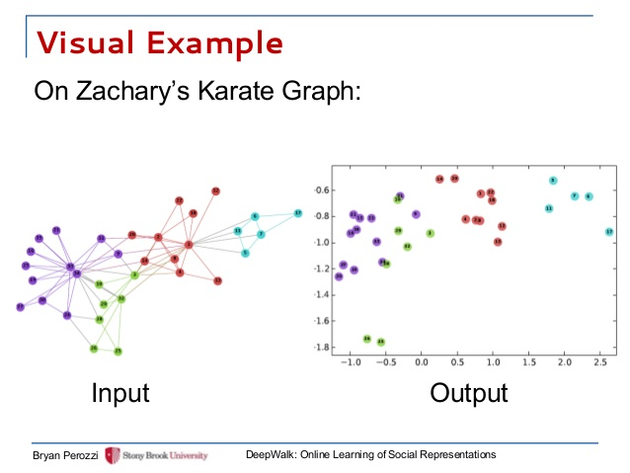
Data reduction

Slide 62
Discretization
Discretization
  reduce the number of values for a given continuous attribute by dividing the range of the attribute into intervals. Interval labels can then be used to replace actual data values.
  E.g. GPA value -> buckets
Concept hierarchies
  reduce the data by collecting and replacing low level concepts (such as numeric values for the attribute age) by higher level concepts (such as young, middle-aged, or senior).

